Slide 1


B1-18 2019
Green Energy - Biogas
-Fueling the Future
Anupama
Mechanical dept
Nandita
Computer science dept
Sai Namruth
Mechanical dept
Madhu Teja
Electronics dept
01

Slide 2

B1-18 2019
PROBLEM
Problem 1
To reduce the usage of Non-renewable resources
Problem 2
Ineffective use of methane gas produced by the
decomposition of daily kitchen waste
02

Slide 3


B1-18 2019
THE UTOPIA
Solution 1
To encourage the use of alternative renewable resources such as Biogas
Solution 2
Capturing the methane gas produced and using it for cooking purposes
03

Slide 4

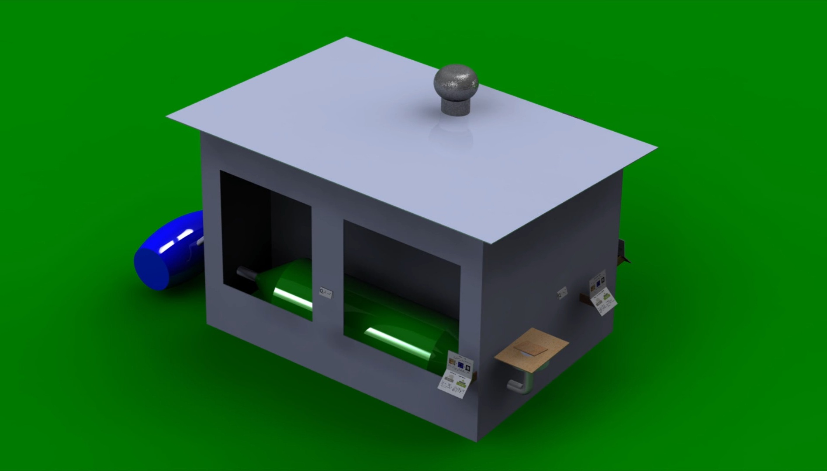
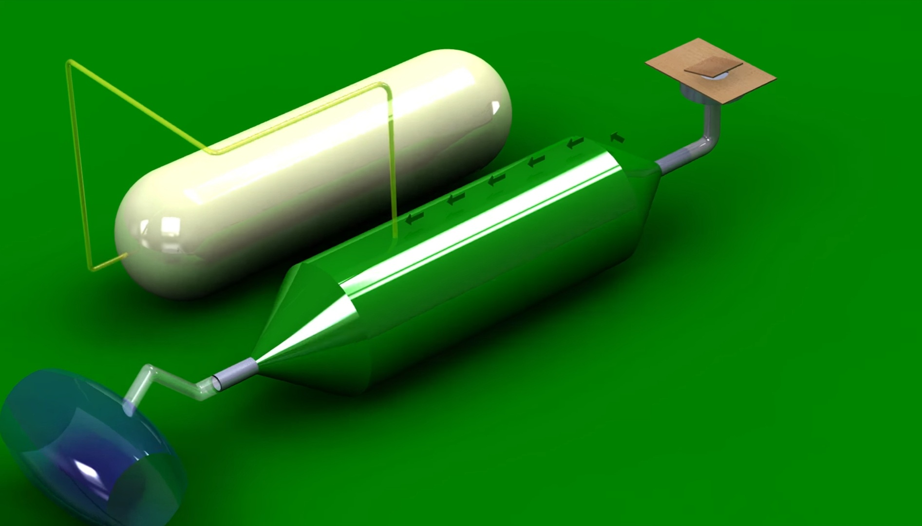
B1-18 2019
PORTABLE
BIOGAS DIGESTER
Introducing portable biogas digestors for household purposes.
Biogas digesters are the machines that process waste into biogas and then channel the biogas so that the energy production can be utilized productively .
04

Slide 5
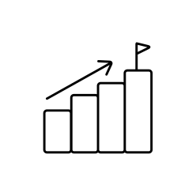

B1-18 2019
COMPETITIVE ADVANTAGES
Advantage 1
It’s a Simple and Low-Cost Technology.
Advantage 2
Environmentally friendly recirculation of
organic waste from households.
Advantage 3
Reduces extra costs for artificial fertilizer.
Advantage 4
Portable digester occupies less space.
05

Slide 6

B1-18 2019
TARGET MARKET
Target Market
People who use LPG for regular cooking purpose
06

Slide 7

B1-18 2019
05
TIMING
Reason 1
Abnormal usage of non renewable sources.
Reason 2
Reserves are becoming harder to
locate and resources won’t last forever
07

Slide 8


B1-18 2019
THE TEAM
Anupama
Mechanical dept
MDM19B034
Nandita
Computer science dept
CED19I056
Sai Namruth
Mechanical dept
MDM19B007
Madhu Teja
Electronics dept
EDM19B005
08

Slide 9




B1-18 2019
CONTACT US
mdm19b007@iiitdm.ac.in
https://www.iiitdm.ac.in
09
09

Slide 10
Thank You !!

